Slide 1

Progress Update: RIDFT
Group 27
Daniel Escobedo Chelsea Armbrister
Brian LaTulip Divyesh Bhakta
Luis Sura Joseph Gwaltney
Sponsor:
Advisors: Dr. Okenwa Okoli
Tarik Dickens
Dr. Nicholas Bembridge
Dr. Peter N. Kalu

Slide 2
Agenda
Background
Introduction
Problem Statement
Needs Assessment
Project Goals/Specifications
Main Issues Encountered
Preconceived Automation Model
Progress Since December
Current Project Status
Project Timeline
Closing Thoughts
Questions

Slide 3
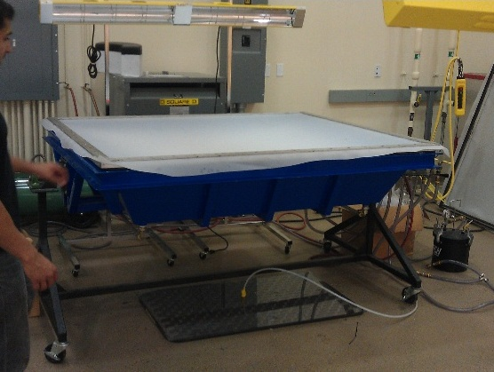
Background
What is the Resin Infusion between Double Flexible Tooling (RIDFT)?

Slide 4
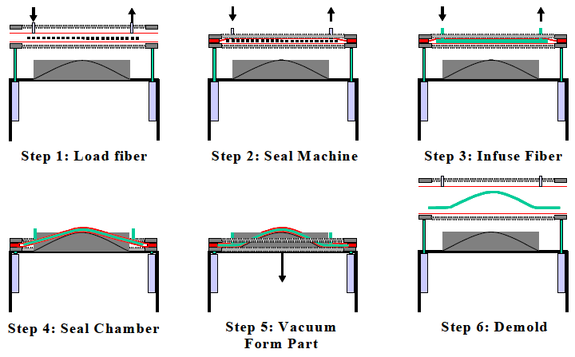
Introduction
How does it work?
What is it used for?
  Polymeric Bound Composites

Slide 5
Problem Statement
Current RIDFT Process Issues:
  Labor Intensive
  Time Consuming
  Process Repeatability
Proposed Solutions:
  Semi-Automation
  Fiber Placement Methodology
  Process Streamlining

Slide 6
Needs Assessment
Develop/Implement methodology for:
  Semi-Automated Placement
  Safe Removal of the Top and Bottom Frames
  Accurate Fiber Placement
Design an Ergonomic Handling System
Minimize Operational Footprint

Slide 7
Project Goals/Specifications
Primary Objectives
  Reduce Overall Process Duration
  Reduce and Enable Safe Manpower Utilization
  Reduce Operational Footprint
Secondary Objectives
  Design and Implement a Method for Accurate Fiber and Mold Placement
  Ergonomic Handling System
Constraints
  Single Operator Utilization
  $3,000.00 - $5,000.00

Slide 8
Main Issues Encountered
Safety
  Components issues
    Links
    Gears
    Hydraulics
Budget
  Previous Estimated Cost≈ $13,000
    New Budget ≈ $3,000 - $5,000

Slide 9
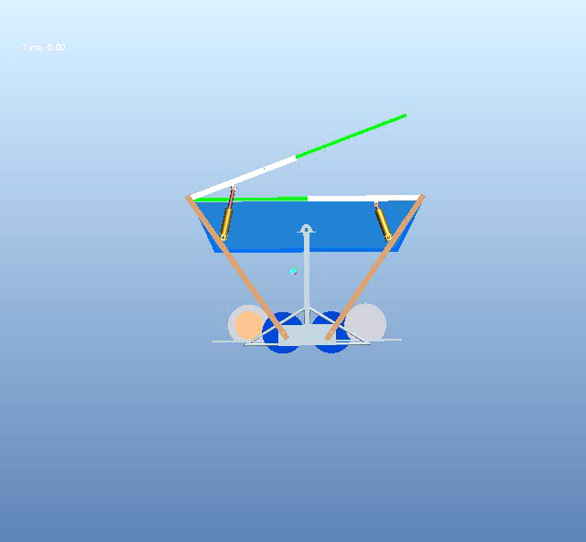
Preconceived Automated Model

Slide 10
Progress Since December
Staff Meeting (ME Staff)
  Discussed issues with previous design
Staff Meeting (Advisor/Customer)
  Discussed:
    Budget constraints
    Safety Issues
    End of Semester Goal
Reassessed Project Timeline

Slide 11
Current Project Status
Term Objective Shift
  Previously: Design and Prototype
  Currently: Detailed Design
System Reassessment
  Safety
  Cost
  “Workability” – ease of operation
  Operational Footprint

Slide 12
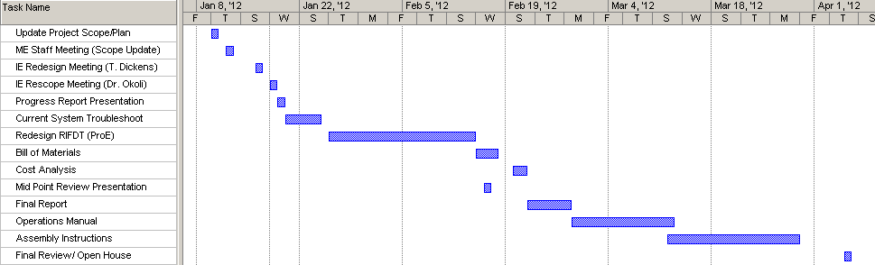
Project Timeline

Slide 13
Closing Thoughts
Shift in Project Goals
  Simply Design
  No Physical Working Model
Improve Upon Previous Years Design
  Increase System Stability/Safety
  Ease of Use
  Portable Semi-Automated System

Slide 14



Questions?

